Slide 1

Hangeover Index.
The
Hangover
Index App
No more

Slide 2
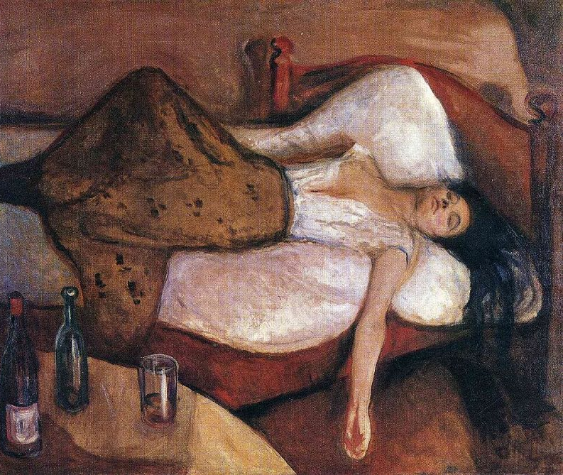
Does this look too familiar?
Saturday morning ruined Friday night?
Have to actually interact with humans but can’t?

Slide 3

Introducing: The Hangover Index App
Using our latest developed algorithm combined with scientific data and real-life case studies to optimize your drinking experience to your own profile.

Slide 4






How does it work?
Personal Profile Age, ethnic background, sex, smoking habits
Hangover Index (1-5)
Scan barcode on the bottle

Slide 5





The Hangover Index App Drink the most, feel the best

